Slide 1



SRM INSTITUTE OF SCIENCE AND TECHNOLOGY
18CSC201J – Data Structures and Algorithms
Unit III- STACK & QUEUE

Slide 2
SESSION 13

Slide 3
Priority Queue
Priority Queue is an extension of a queue with following properties.
Every item has a priority associated with it.
An element with high priority is dequeued before an element with low priority.
If two elements have the same priority, they are served according to their order in the queue.

Slide 4
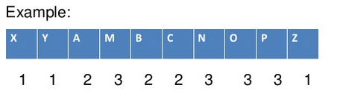
Priority Queue Example

Slide 5
Operations Involved
insert(item, priority): Inserts an item with given priority.
getHighestPriority(): Returns the highest priority item.
pull_highest_priority_element: remove the element from the queue that has the highest priority, and return it.

Slide 6
Implementation of priority queue
Circular array
Multi-queue implementation
Double Link List
Heap Tree

Slide 7
Node of linked list in priority queue
It comprises of three parts
Data − It will store the integer value.
Address − It will store the address of a next node
Priority −It will store the priority which is an integer value. It can range from 0-10 where 0 represents the highest priority and 10 represents the lowest priority.

Slide 8
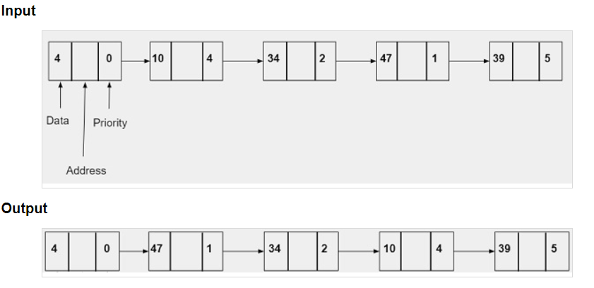
Example

Slide 9
Double Ended Queue
Double Ended Queue is also a Queue data structure in which the insertion and deletion operations are performed at both the ends (front and rear).

Slide 10
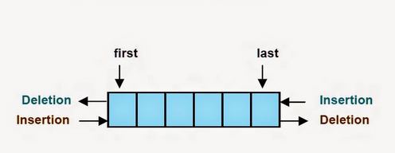
Double Ended Queue
Double Ended Queue can be represented inTWO ways
Input Restricted Double Ended Queue
Output Restricted Double Ended Queue

Slide 11
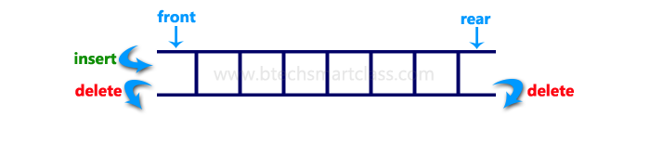
Input Restricted Double Ended Queue
In input restricted double ended queue, the insertion operation is performed at only one end and deletion operation is performed at both the ends.
Input Restricted Double Ended Queue

Slide 12
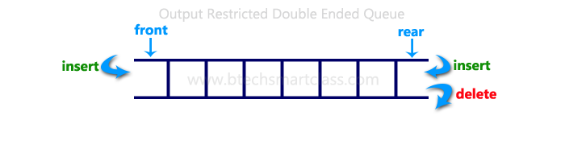
Output Restricted Double Ended Queue
In output restricted double ended queue, the deletion operation is performed at only one end and insertion operation is performed at both the ends

